Slide 1
TOPIC A1:
COMPUTER FUNDAMENTALS
LESSON A1-6
OPERATING SYSTEMS

Slide 2
AGENDA
The Operating System
Abstraction
The nine functions
OS Safari Zone
Background Operations and Integrity
Lab
WHAT U NEED 4 LESSON
Guided Notes
Your Laptop
ur hedz

Slide 3

THE WARM UP QUESTION
(a) State the Boolean operator that outputs 1 only when both inputs are 0.
(b) Complete using De Morgan: NOT(A OR B) = ______________
(c) In a three-variable Karnaugh map, a group of four cells removes how many variables?
-> Notes Q1 (a)-(c)

Slide 4
THE WARM UP ANSWER
(a) NOR
(b) NOT A AND NOT B - invert both inputs and flip the operator
(c) Two. A group of four leaves one variable out of three

Slide 5




THE OPERATING SYSTEM
So far, we’ve discussed hardware, and what the numbers on that hardware can mean, but none of it is usable on its own
A CPU cannot open a file, because a file is not a thing the hardware knows about
The operating system is the software layer that turns hardware into something a program can use

Slide 6
ABSTRACTION
Abstraction - hiding complexity behind a simple interface
Your Python program says open("data.txt”)
It doesn’t specify what physical part of your hard drive to go to, or a memory address, or anything like that
The same open() works on an SSD, an HDD and a network drive
The implementation of open() is ABSTRACTED
Hopefully, today we’ll peel back just a bit of that abstraction

Slide 7
ABSTRACTION ON YOUR NOTES
-> Notes Q2 (a)-(b)
Q2 (a) Define abstraction as it applies to an operating system. [1]
Q2 (b) A program saves a file. State two hardware details the OS hides from that program. [2]

Slide 8
THE NINE FUNCTIONS
The IB names the following nine specific functions
Memory Management | Security | Virtualization
File System | Accounting | Networking
Device Management | Graphical User Interface (GUI) | Scheduling

Slide 9
OS SAFARI ZONE
Using our laptops we will (attempt) to find all nine functions
Open Task Manager now: Ctrl + Shift + Esc
Keep this open during the safari
You’ll jot down some numbers from our hunting
We won’t be breaking anything, so don’t worry about that either, just observing
If something is blocked by your school account, oops my bad – write it down and list it as security!

Slide 10

SAFARI ZONE 1 - MEMORY MANAGEMENT
Task Manager -> Performance -> Memory
Find three numbers: In use, Available, and Committed
The second half of Committed is likely bigger than your actual RAM
That extra is the page file on your secondary storage instead of your primary to buy you more space
Then do Task Manager -> Processes -> click the Memory column to sort
Whatever is at the top is what program is using the most memory
Write down how much committed memory is used and compare

Slide 11

SAFARI ZONE 1 - FILE SYSTEM
File Explorer -> right-click This PC > Local Disk (C:) -> Properties
The file system is named on that first tab
It should say NTFS
Now: make a new text file on your desktop, type one sentence, save, close, then right-click it and look at Properties
Compare Size with Size on disk
Are they the same?
If Size on disk says 0 bytes, your file is small enough that NTFS kept it inside its own index instead of giving it a full memory block.
NTFS sorts files into blocks of 4KB in size

Slide 12
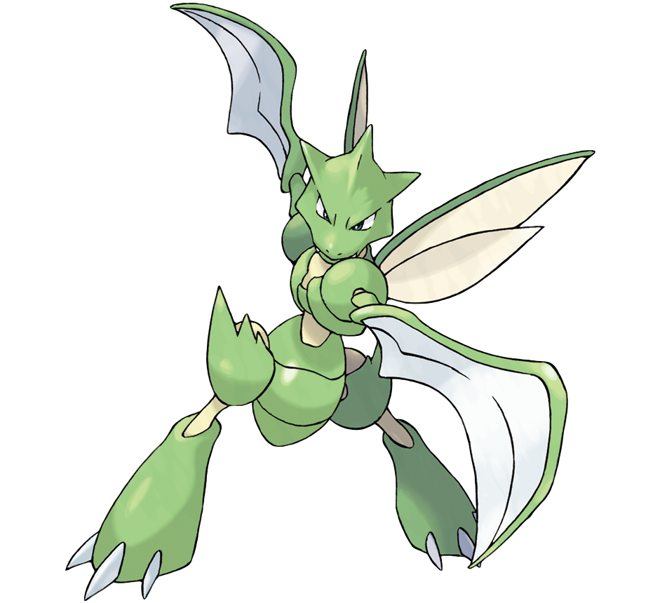
SAFARI ZONE 1 - DEVICE MANAGEMENT
Start menu -> type Device Manager -> expand Keyboards -> double-click -> Driver tab
That is a driver: the code that translates a general request into this exact device’s format
Click Driver Details for the actual .sys files the OS loads to talk to your keyboard
-> Notes Q3 - memory management, file system, device management

Slide 13
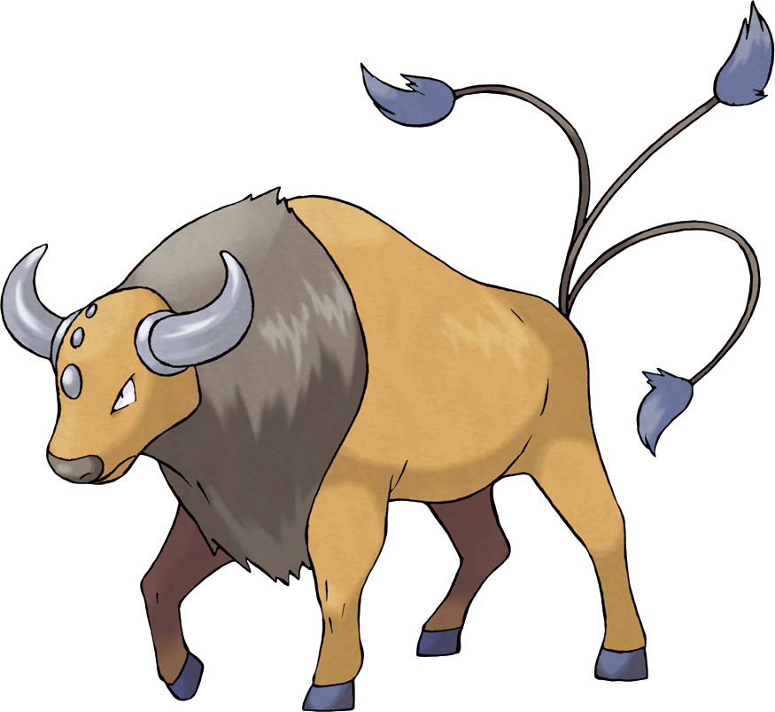
SAFARI ZONE 2 - SCHEDULING
Task Manager -> Performance -> CPU
Read four numbers off the bottom: Processes, Threads, Logical processors, Up time
Threads is usually two to four thousand
This is how many different “program parts” your computer is managing
Your logical processors is based on how many cores your CPU has
This represents how many different “CPUs” the threads have to run on – they have to ‘share’ time on those CPUs
Now right-click the graph -> Change graph to -> Logical processors
Try playing a YouTube video, or switching to the roblox running in the background (cole) and see what happens

Slide 14


SAFARI ZONE 2 - SECURITY
Task Manager -> Details / Processes -> right-click the column headers -> add User name
Some processes belong to you, some belong to SYSTEM (those are restricted OS functions)
Now open Command Prompt and run whoami /priv - that is the list of things your account is and is not allowed to do
Assuming they finally unblocked command prompt
Then try to save a text file into C:\Windows
What happens?
Process isolation is the same idea one level down: your program cannot read another's memory just because it asked.

Slide 15

SAFARI ZONE 2 - ACCOUNTING
Task Manager -> Users -> expand your own name
CPU, memory, disk and network, itemised per user
This is accounting: the OS keeping track of what’s occurring on the computer
Then go to Settings -> System -> Storage, and wait for it to finish tallying up
This is the OS reporting its accounting to you
-> Notes Q3, rows 4 to 6 - scheduling, security, accounting

Slide 16

SAFARI ZONE 3 - THE GUI
Trust the process here
Task Manager -> find Windows Explorer -> End task
Your taskbar and desktop should vanish – but not every program you had open will close
We’ve turned off the GUI and left the operating system running underneath it
It should automatically come back, but if it doesn’t:
To get it back: Task Manager -> File -> Run new task -> type explorer -> OK
A GUI is one function of an OS, not the definition of one
For example, a server runs with no GUI at all

Slide 17
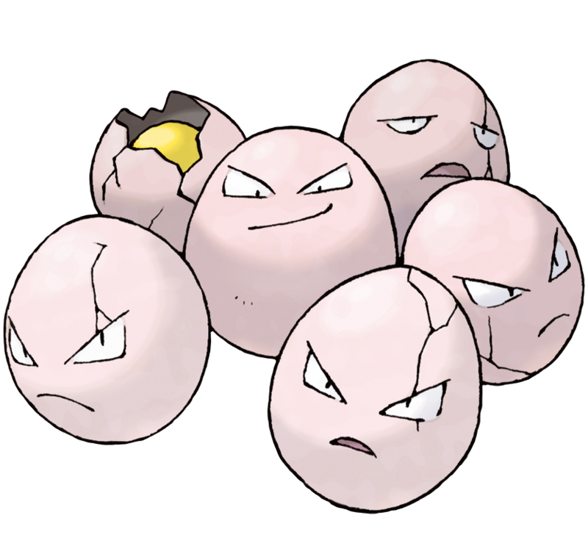
SAFARI ZONE 3 - VIRTUALIZATION
Task Manager -> Performance -> CPU -> read the right-hand column
There is a line that says Virtualization: Enabled
This means that your computer is ready to simulate another computer
Should the need arise, which it probably won’t for you
This functionality supports cloud computing, leading to SaaS, PaaS, and IaaS
Each virtual machine believes it has its own CPU, memory and disk, and cannot see the others
If yours says Disabled, that is a BIOS setting – just jot down what you have

Slide 18

SAFARI ZONE 3 - NETWORKING
Task Manager -> Processes -> click the Network column to sort
Command Prompt -> netstat –ano
Again, SHOULD be unblocked by now
Each of these is a connection your computer is making to a server or some other network device
Count the number of these that say established
Most of these are either school required programs or background tasks, like stuff from Microsoft
The OS gave every one of those a connection and shares a single network card between all of them
-> Notes Q3, rows 7 to 9

Slide 19

SAFARI WRAP UP
Double check your process list
You maybe have 4 or 5 apps you’ve opened, but there’s well more processes than that
The rest are background operations: writing logs, indexing files for search, checking for updates, expiring caches, watching for devices, managing memory
All of it competes for the same CPU and memory as your work, which is why a machine can be so slow even when it looks like it’s doing nothing
The operating system is why WE don’t have to choose to run

Slide 20

SYSTEM INTEGRITY
System integrity is the machine staying in a correct, consistent, working state
The fact that we were able to kill the whole program’s GUI and the computer didn’t crash is because of system integrity
A crashing program should take only itself down, and its memory should come back
A file half-written when the power fails should not corrupt the whole file system

Slide 21
YOUR NOTES
-> Notes Q4 (a)-(c) and Q5 (a)-(b)
Q4 Name the function responsible for: (a) two programs sharing CPU time, (b) a new printer working with no manual code written by you(c) a school tracking disk space per account. [3]
Q5 (a) State what is meant by system integrity. [1]
Q5 (b) Describe one background operation and explain why it matters. [2]

Slide 22

Q6 Describe the role of an operating system, with reference to abstraction. [3]
Q7 Explain how memory management and security work together to stop one program crashing another. [3]
Q8 A school is choosing between twenty physical servers and one server using virtualization. Explain two advantages of the virtualization option. [4]

Slide 23


JOHN IB’S PRO TIPS
Pay attention to the command terms here:
'Describe' wants what it is and what it does. 'Explain' wants a because in the sentence
Q8 is four marks for two advantages, so each one needs a point and a reason

Slide 24

VOCABULARY TO REMEMBER
Operating system
Abstraction
Memory management
Committed memory
Page file
File system
Size on disk
Driver
Scheduling
Thread
Logical processor
Process isolation
Accounting
GUI
Virtualization
System integrity

